Slide 1
LINUX DEVICE DRIVER
DAY 3 PPT
-SUBITHRA S

Slide 2
CMD | USE
ls | List files in current directory.
cd | Change directory.
pwd | Print current working directory.
mkdir | Create a new directory.
touch | Create a new empty file.
cp | Copy files and directories.
man | Display the manual page for a command.
cat | Display the contents of a file.
echo | Display text or variables.
whoami | Prints the username of the current user.
history | Displays a list of previously executed commands.
gedit | Opens the Gedit text editor to edit files.
$HOME | Prints the path to the current user's home directory.
$PWD | Prints the path to the current working directory.
$USER | Prints the username of the user
nano | Nano is for editor
cat | displays the contents of files.
ls -l | Lists files and directories in long format, showing permissions, ownership, size, and modification time.
ls -rl | Lists files and directories in reverse order and in long format, showing permissions, ownership, size, and modification time.
/ | Root
/bin | bare essential commands
/boot | OS kernels
/dev | hardware devices
/etc | system files,config
/home | home dirctories
/lib | libraries needed by system
/opt | 3rd part applications
/proc | Running process
/sbin | administrative
/tmp | temporary space
/usr | OS application
/var | Logs,databases

Slide 3
LINUX:
Linux OS is a type of computer operating system that is free and open-source, distributed under the GNU General Public License (GPL) that allows users to download, install, and modify the operating system’s source code for free. Linux OS consists of the Linux kernel developed by Linus Torvalds and various software developed by the open-source community. As a free and open-source operating system, Linux OS has become popular among computer users who have an interest in technology and want to understand more about how an operating system works. Additionally, Linux OS is also used by many companies and organizations worldwide due to its ability to be modified and customized to meet their needs.
History of Linux OS
This operating system is built upon the Linux kernel (the core of the operating system) which was first released in 1991 by Linus Torvalds, a student from the University of Helsinki, Finland. Initially, Linux was only developed as a hobby and was not intended for widespread use.

Slide 4
Cd and ls commands
"cd" command is used to change directory location. Without an argument, "cd" takes you to your home directory
"Is" command is used to list the files in a directory. Like many Linux commands, it can take a number of "flags" as options to change the behavior of the command
mkdir : to create new directory

Slide 5
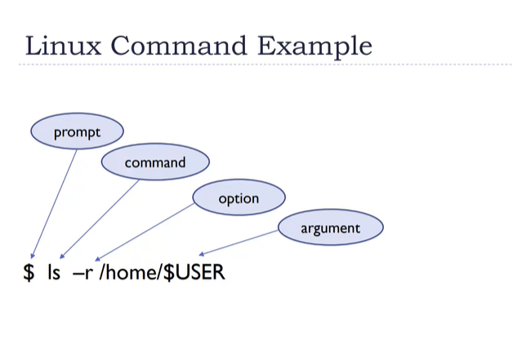
Ownership
▸ Files and directories have three types of access permissions:
read permission (r)
write permission (w)
execute permission (x)
▸ Every file and directory has permissions for three levels or entities of permissions:
a) user or owner (denoted by u)
b) group (one or more users denoted by g)
c) others or world (denoted by o)

Slide 6
FILES AND PROCESSES
In linux, everything is either a file or a process. Meaning everything can be interfaced via the file systems.
Files: text, data, documents, traditional files
Directories: directories are special text files that contain a bunch of other files Devices: all disks, video hardware, audio hardware, processors, memory, USB ports - all hardware can be interfaced via files
Processes: all running processes can be "seen" via the file system (in /proc) each has a unique identifier (PID)

Slide 7
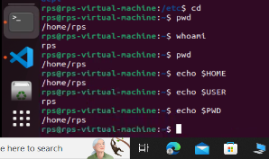
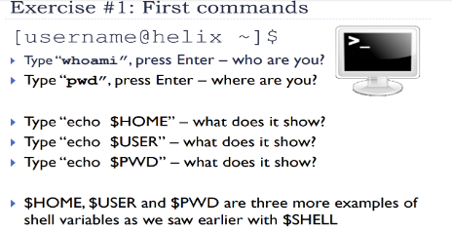
Current working directory is printed
Current username is displayed
Displaying the home variable
Displaying the user variable
Displaying the current working directory variable

Slide 8
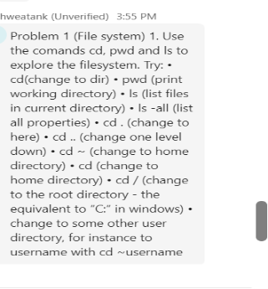
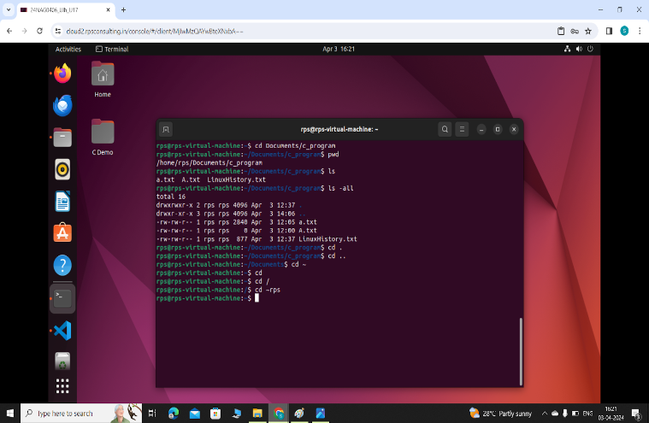
Change directory is done
Current working directory is printed
List is mentioned
Returned to parent folder
Navigated to root folder
Navigated to parent folder

Slide 9
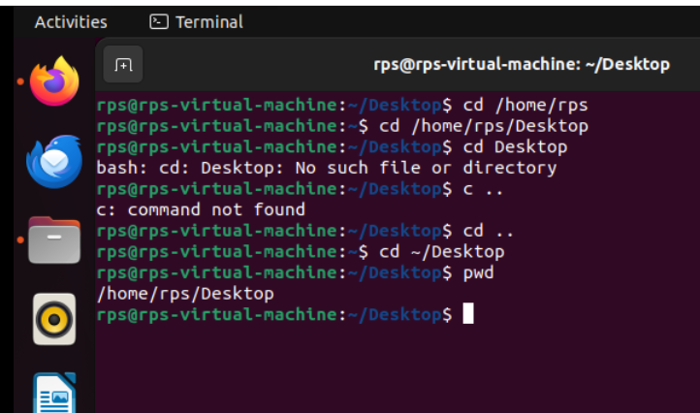
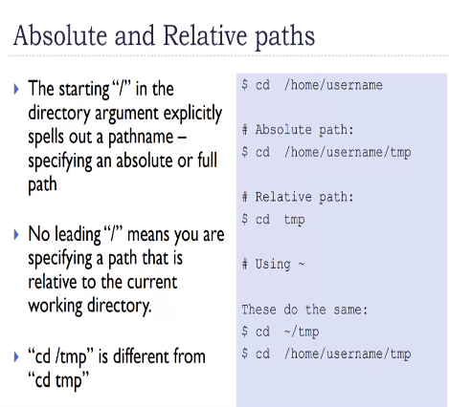

Slide 10
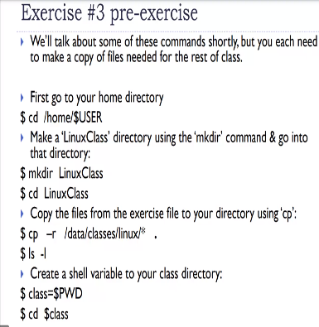
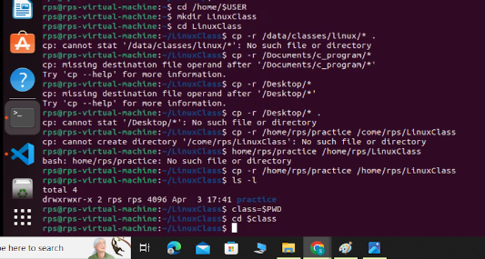
Changing directory
LinuxClass folder is created using mkdir
Copying the file to another folder
Listing of contents
Shell variable with current working directory is printed

Slide 11
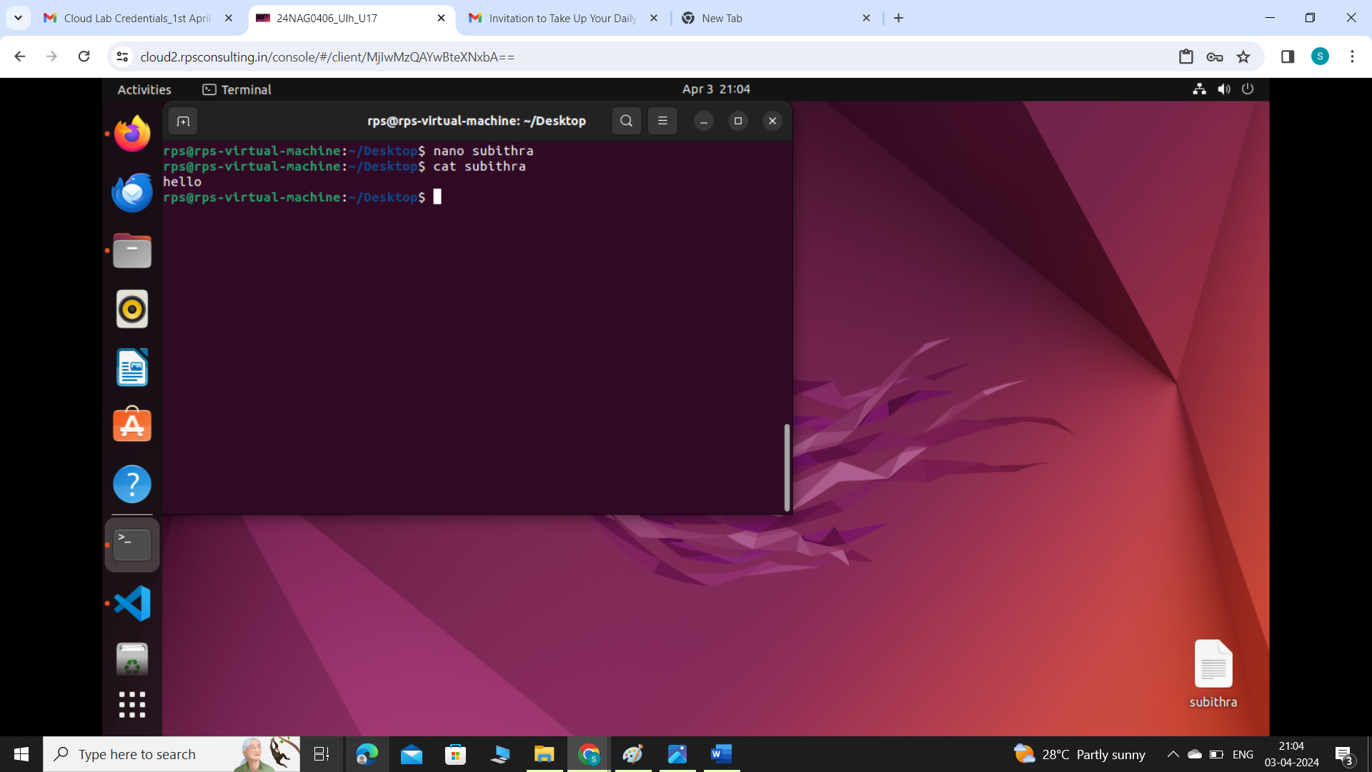
NANO COMMAND
Ctrl + g : Display the help menu, which provides a list of available commands.
Ctrl + o : Save the file.
Ctrl + x : exit nano , If changes have been made, nano will prompt you to save them before exiting.
Ctrl + w : Search for text.
Ctrl + k: Cut the current line.
Ctrl + u: paste the last cut text.
Ctrl + c: Display current cursor position
Using nano editor “Hello” text is written in folder named subithra
Using CAT the content inside the subithra file is displayed

Slide 12
THANK YOU

